Slide 1

Online Restaurant System
Submitted by:
Harsh Kumar

Slide 2




CONTENTS
Introduction
Screenshots
Sample Codes
Future Enhancements

Slide 3
Introduction
Online Restaurant System will be used for ordering food from a restaurant or food co-operative through a web page. Much like ordering consumer goods online, many of these allow customers to keep accounts with them in order to make frequent ordering convenient. A customer will select the favorite food item usually filtered via type of cuisine and choose from available items and choose delivery or pick-up after the successful transaction.

Slide 4
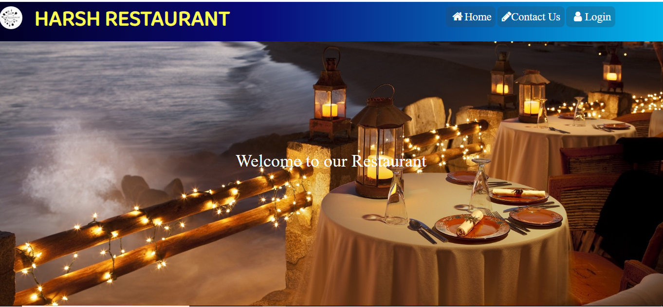
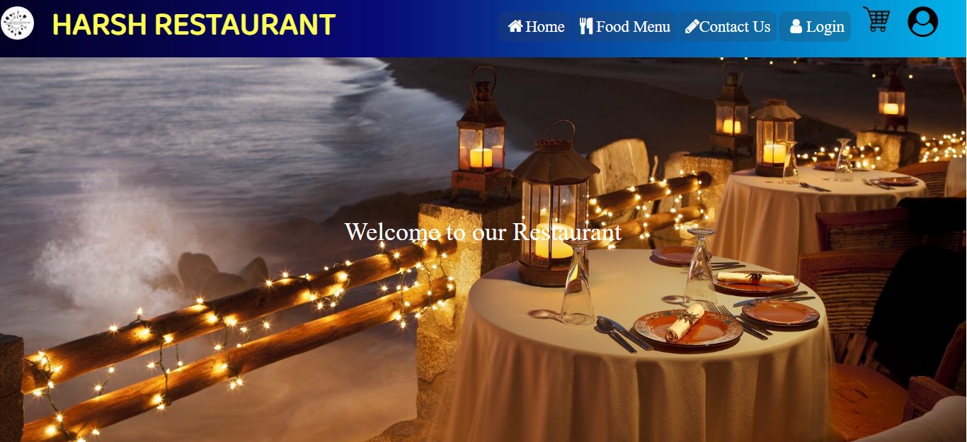
HOMEPAGE
Before Login
After Login

Slide 5
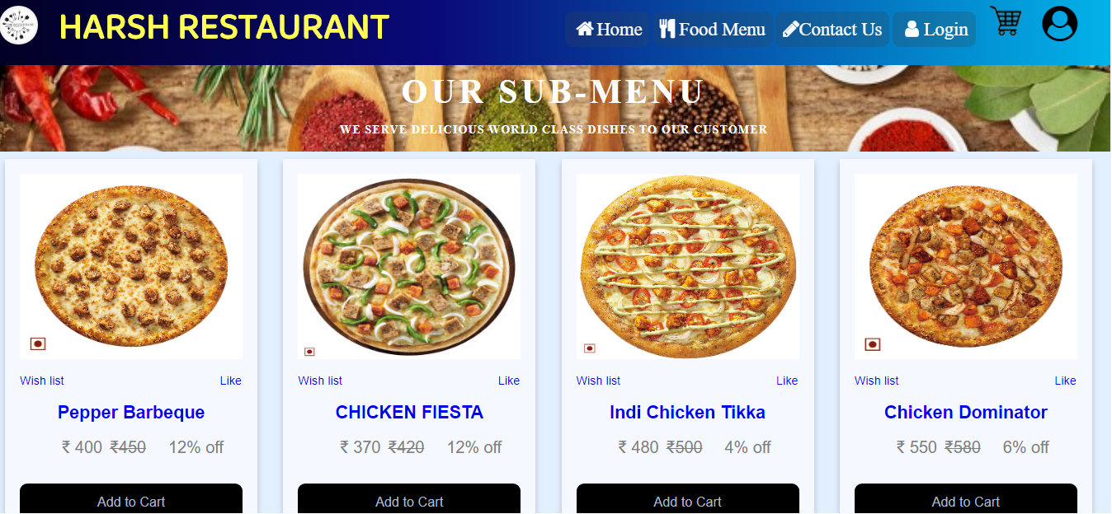
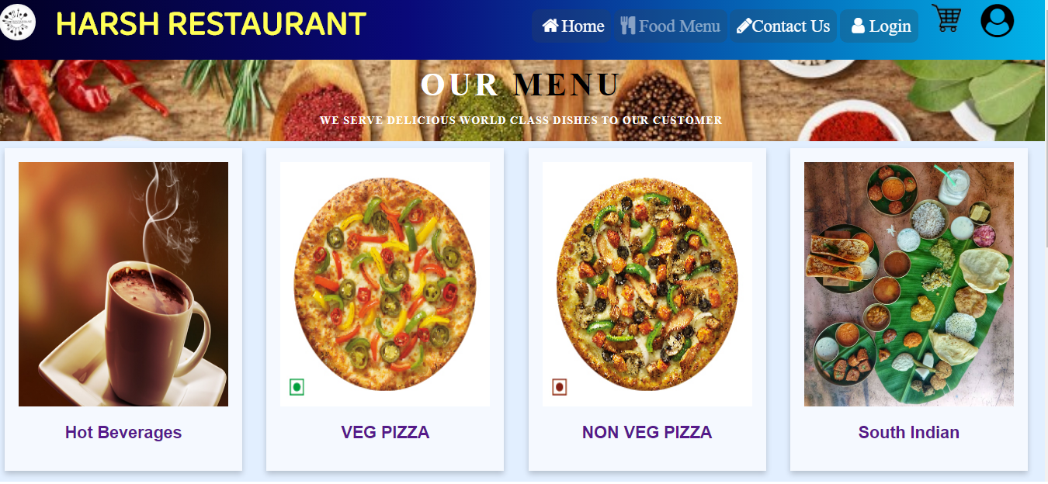
Menus
Main Menu
Sub Menu

Slide 6
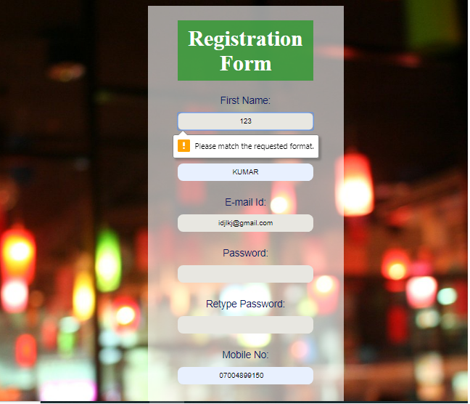
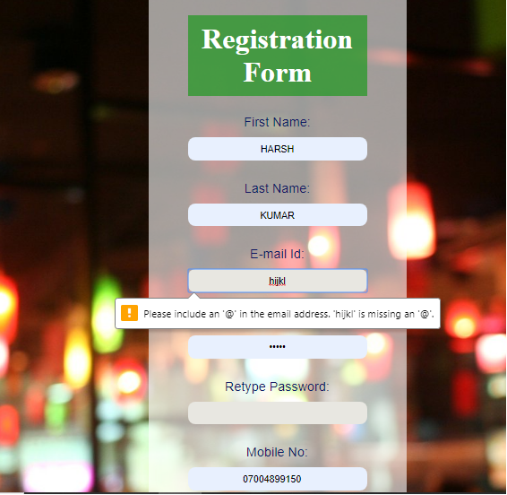
Form Validation
In the First Name and the Last Name only the character value from a to z will be accepted
While entering the email id it will popup the message to write the email id correctly

Slide 7
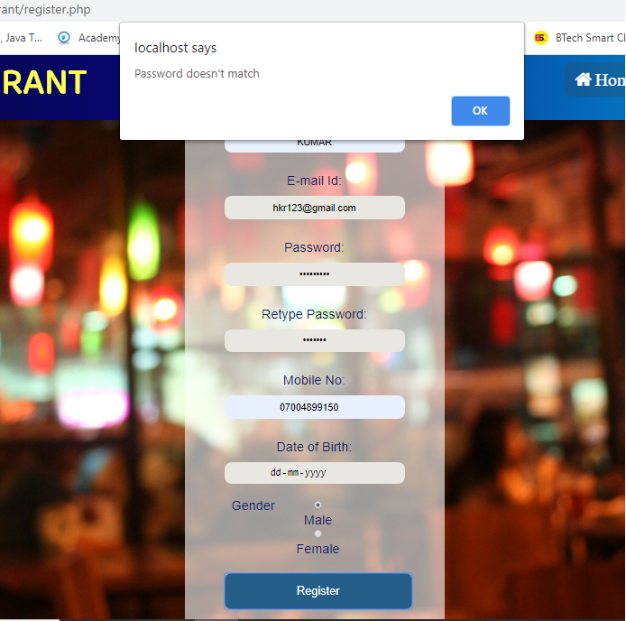
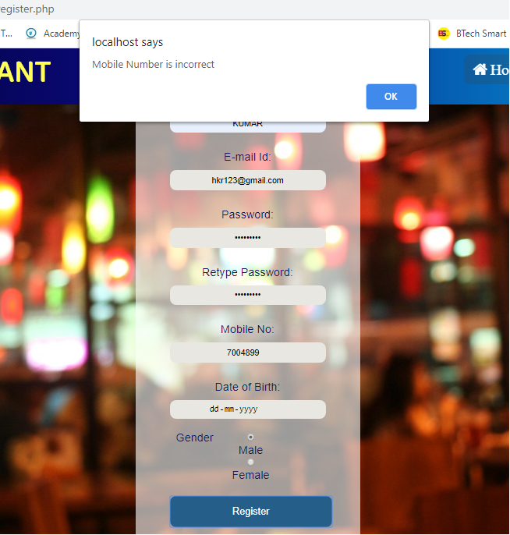
Form Validation (cont.)
There is password validation in which if the password field and retype password field doesn’t match the JavaScript will display an alert to correct the password.
The Mobile Number should be precisely 10 digits numbers otherwise the alert will be displayed.

Slide 8
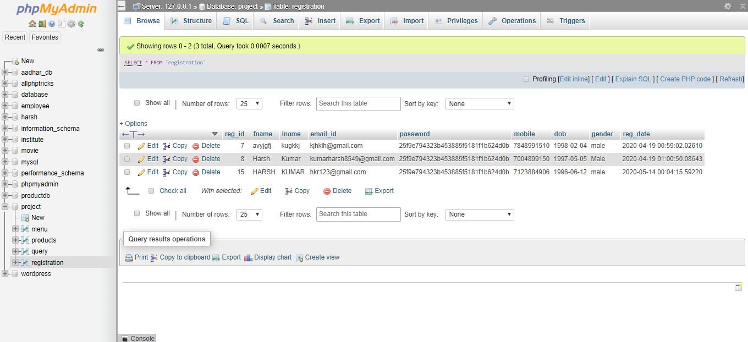
Registration Form Database
The user is being registered with the registration id 15 and later the email and the password(md5 encryption) will be used to login in the website.

Slide 9
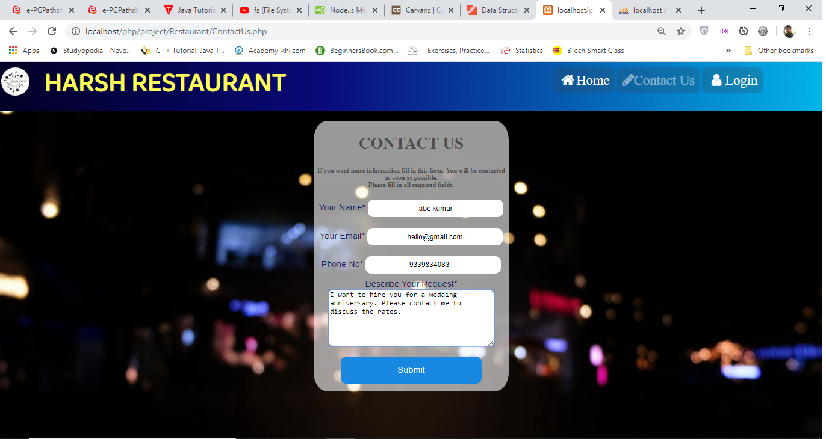
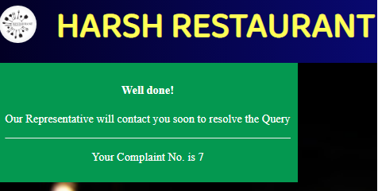
Forms With DB Connectivity
Let’s do the dB connectivity on the contact form where the user filled the required fields after submission of the form it goes on the query table in database and from there a complaint id will be generated for the user for future use.

Slide 10
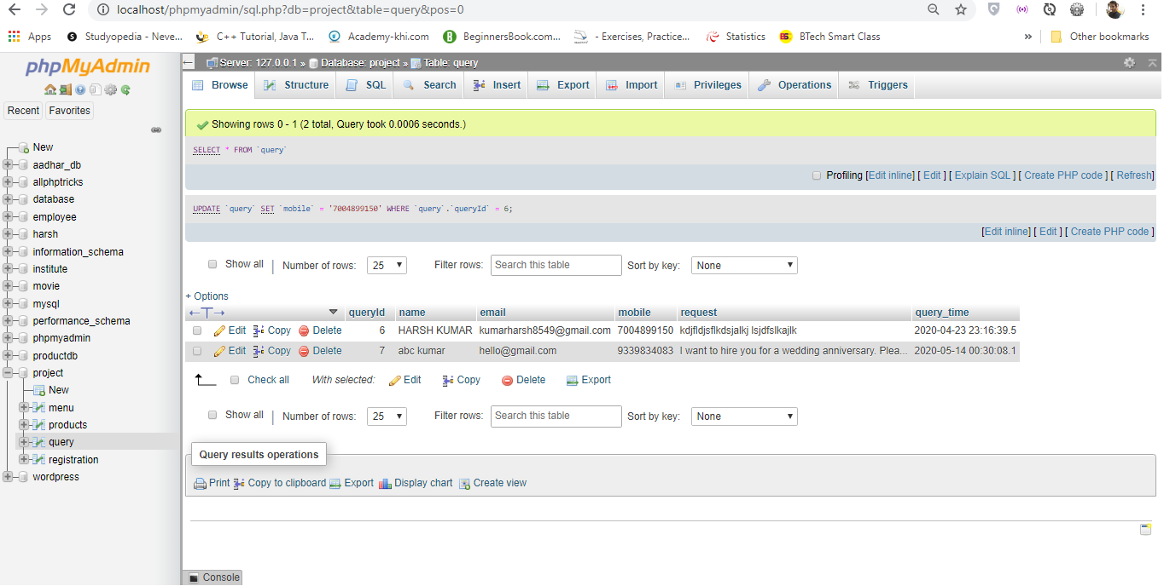
Forms With DB Connectivity (cont.)

Slide 11
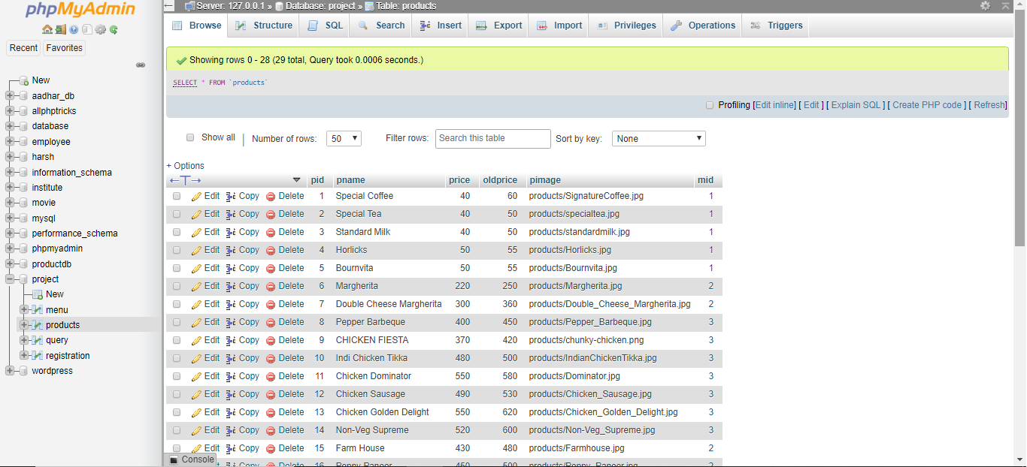
Sub Menu Database

Slide 12
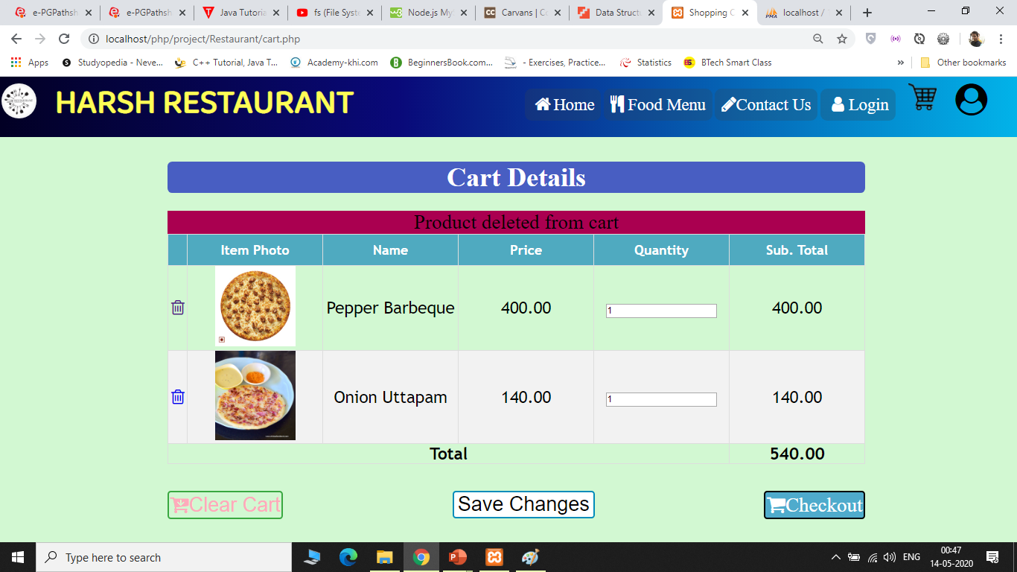
Item Cart(using Sessions)

Slide 13
Sample Code (Login)
<?php
session_start(); //starting a session
error_reporting(E_PARSE); //removes the error when user is not logged in
if ($_SESSION['uid']) {
echo "<script> alert('You Must Logout First. We are redirecting to logout Page');</script>";
echo "<script>setTimeout(\"location.href = 'logout.php';\",1000);</script>";
} //If user already logged in and trying to enter the login page again it will be redirected to logout page
else if(empty($_SESSION['uid'])){
?> // If browser do not find any session in the browser menu the below code will be executed
<!DOCTYPE html>
<html>
<head><title>Login</title>
<link rel=stylesheet href="style.css?version=51?"> //external css
<link href="https://fonts.googleapis.com/css2?family=Baloo+Paaji+2&display=swap" rel="stylesheet"> //using google fonts in navigation
<link rel="stylesheet" type="text/css" href="css/styles.css?version=51"> //another external css
<link rel="stylesheet" href="https://cdnjs.cloudflare.com/ajax/libs/font-awesome/4.7.0/css/font-awesome.min.css"> //some icon of font-awesome
</head>

Slide 14
Sample Code Login(cont.)
<body class="login"><header> //Navigation Bar
<nav style="width: 100%; border-radius: 0 0 0 0; height: 70px;">
<a href="index.php"><div class="logo"> <img src="images/logo.jpg" alt="Logo"><p style="font-family: 'Baloo Paaji 2', cursive; font-size: 50px; margin-top:-15px;">Harsh Restaurant</p></div></a><div class="menu"> <ul class="ul">
<li class="li"><a href="index.php"><i class="fa fa-fw fa-home"></i>Home</a></li> <li class="li"><a href="ContactUs.php"><i class="fa fa-pencil" aria-hidden="true"></i>Contact Us</a></li> <li class="li"><a href="login.php" class="active"><i class="fa fa-fw fa-user"></i>Login</a></li> </i></a></ul> </div></nav></header><div class="contain">
<?php
if(isset($_POST['query'])){
$username=$_POST['user'];$password = md5($_POST["pass"]); //user input for name and password(md5)
include 'connection.php’; //db connectivity using another php
$sql = "SELECT * FROM registration WHERE email_id = '$username' AND password = '$password'";
$query = mysqli_query($conn,$sql);
$count = mysqli_num_rows($query); //if user record is available in database then $count will be equal to 1
if($count == 1){ //successful login
$row = mysqli_fetch_array($query);
$_SESSION["uid"] = $row["reg_id"]; //storing registration id in session variable
$_SESSION["name"] = $row["fname"]; //storing fname in session variable
echo "login Success";
header("location:profile.php"); //redirect to user profile page
}else{ // if username or password doesn’t match in the database alert will be shown
echo "<script>alert('UserName or Password is Incorrect. Please check and login again');</script>";?><?php}}?>

Slide 15
Sample Code Login(cont.)
<form class="form1" id="form1" action="login.php" method="POST" onsubmit="return validForm()"><h1 id="log">LOGIN</h1> //after JavaScript validation the php code will execute
<input type="email" name="user" id="ser" placeholder="Username" class="box"><br>
<input type="password" name="pass" id="pass" placeholder="Password" class="box"><br>
<button value="Submit" name="query">Submit</button>
</form>
<span id="dont">Don't have an Account?</span><a id="reg" href="register.php">Register</a> //To register
</div>
<script type="text/javascript"> //empty validation
function validForm() {
var use=document.forms["form1"]["user"];
var pas=document.forms["form1"]["pass"];
if (use.value=="") {
alert("UserName cannot be empty");
return false;
}
if(pas.value==""){
alert("Password Field cannot be empty");
return false;
}
}
</script></body></html>
<?php } ?>

Slide 16
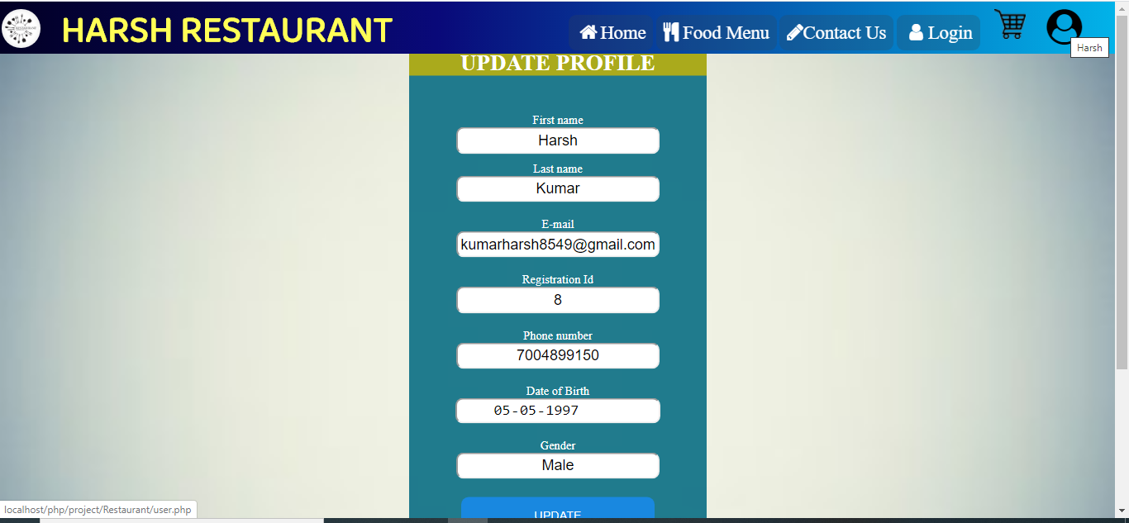
User Profile
We can perform the update operation in the database field of the current user. Only the registration id will non-editable.

Slide 17
Future Enhancements
More user friendly desktop experience.
Flexible login and registration by Facebook, Gmail integration.
Allow customers to provide cart and menu without login.
Save Payment details for future use.
Order History for customers.
Delivery Tracking.

Slide 18
Conclusion
This project entitled “Restaurant Management System” has been proposed to be implementing by providing the “Harsh Restaurant” offline business to attract more customers using online platform. The project is achieved by the use of Html, CSS, JavaScript and PHP. The users can add any number of food items to the cart from any of the available food categories by simply clicking to the Add to Cart button for each item.

Slide 19
THANK YOU!
Harsh Kumar
Email:
kumarharsh8549@gmail.com
Phone:
7004899150
Download my project:
https://github.com/harshmgr/Restaurant

